Slide 1
We will be starting soon!
Thanks for joining us

Slide 2
How to Market Yourself as a High-Performance Professional
Jay Gentry, Passive House California
August 16, 2022
Notes:
Afternoon All,
Thanks for joining us! My name is Ian Logan with 3C-REN working out of the County of Ventura.
As everyone gets settled, I will run through our 3C-REN program overview to help familiarize you all with what we have on offer

Slide 3
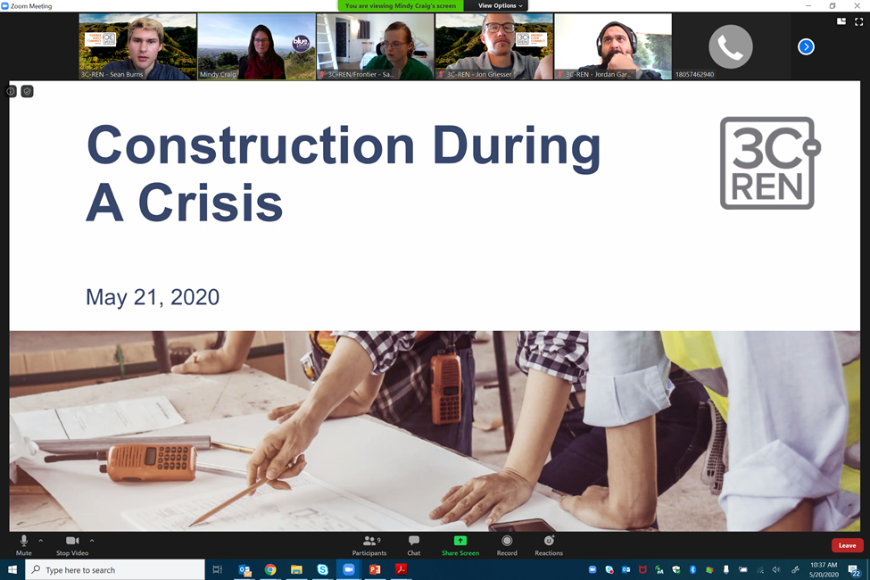
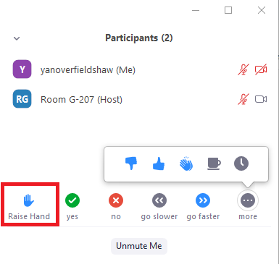
Zoom Orientation
Please be sure your full name is displayed
Please mute upon joining
Use "Chat“ box to share questions or comments
Under "Participant" select "Raise Hand"
to share a question or comment verbally
The session may be recorded and posted to 3C-REN's on-demand page. Feel free to ask questions via the chat and keep video off if you want to remain anonymous in the recording.
Notes:
I'm sure by now most of you are probably very familiar with ZOOM, but we ask that everyone make sure they are on mute throughout the duration of the training. If you would like to verbally participate, we will either invite you to, or please raise your hand in the participants section.
We encourage you to participate and ask questions through the chat box. If you would like to now you can introduce yourself, maybe include your full name, profession, and where you are tuning in from today.
Lastly, for attendance purposes if everyone can make sure their screen name displays their first and last name. You can rename yourself by selecting the dropdown menu next to your tile or in the participants section.

Slide 4
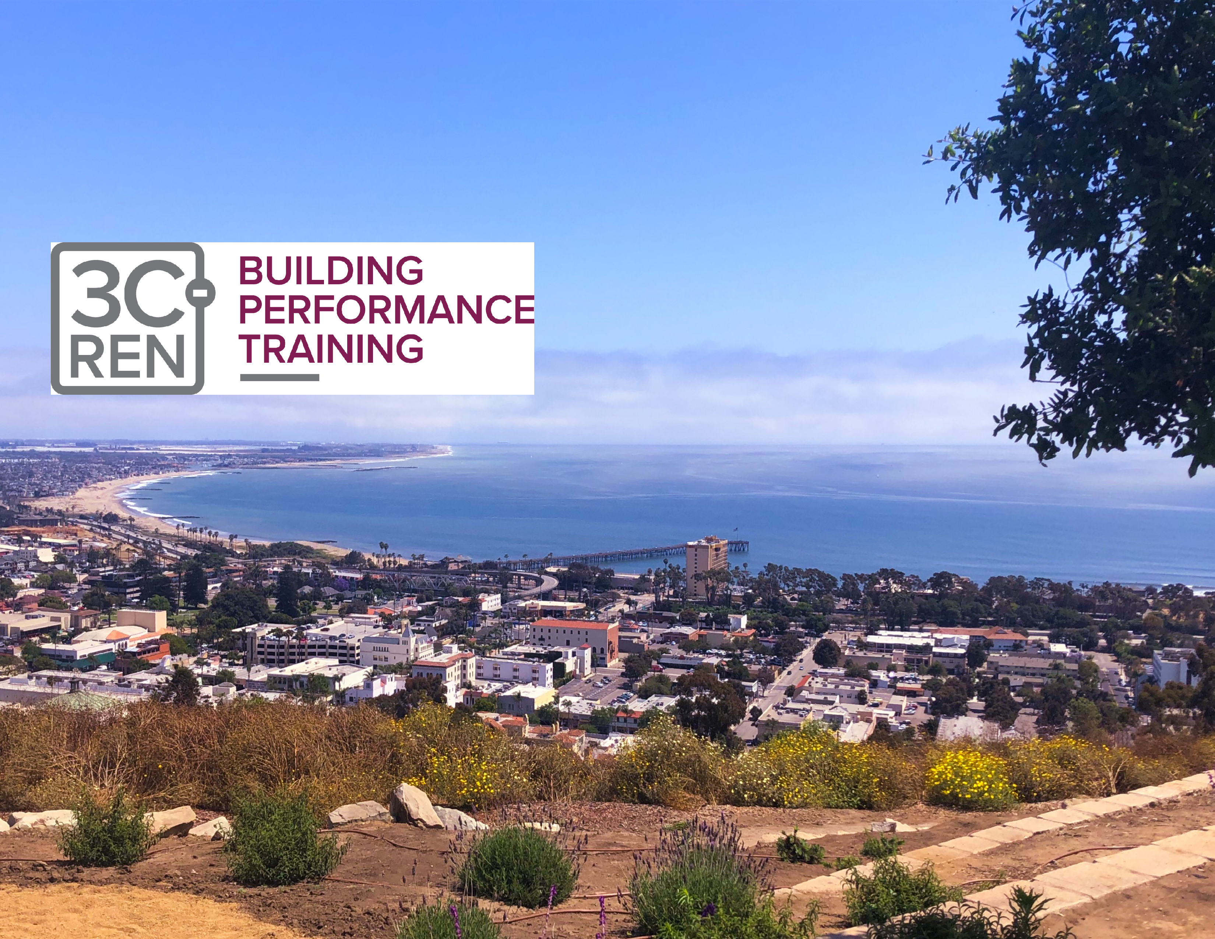
3C-REN
Staff Online
Notes:
There are a few staff members on the training today, feel free to chat them directly with any questions you may have.
Today’s course is designed to be an introduction to Residential ZNE, if there are any concepts or building techniques that you have questions about, Please don’t hesitate to ask.
With that, I’ll leave it to Terry to get things rolling this morning. Welcome Terry

Slide 5
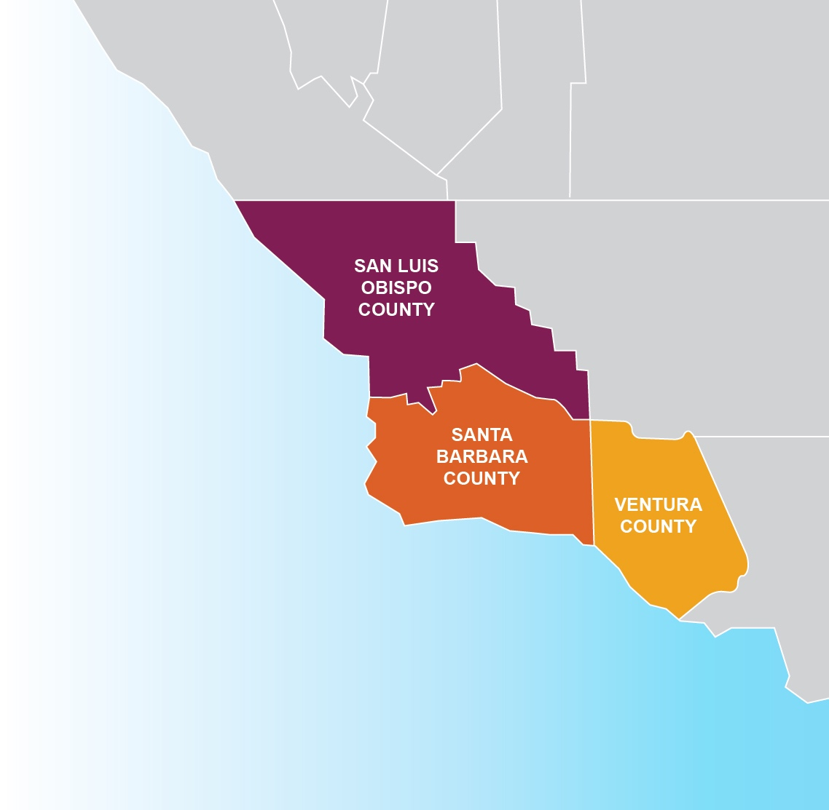
3C-REN: Tri-County
Regional Energy Network
  Three counties working together to improve energy efficiency in the region
  Services for –
    Building Professionals: industry events, training, and energy code compliance support
    Households: free and discounted home upgrades
  Funded by ratepayer dollars that 3C-REN returns to the region
Notes:
We are the Tri-County Regional Energy Network, aka 3C-REN
Is a collaborative partnership between San Luis Obispo, Santa Barbara and Ventura Counties
To improve energy efficiency in our region by offering free programs and services for all building professionals and households
3C-REN is funded by ratepayer dollars that we all pay into in our utility bills through the Public Goods Charge.
The benefit of being ratepayer funded is that there is no cost to those we serve
And as a Regional Energy Network we are able to return these dollars back to our local economy which has historically missed out on some of these funds.

Slide 6



Notes:
3C REN currently offers 3 programs

Slide 7
3C-REN Programs
Energy Code Connect (ECC)
  Industry Trainings and Regional Forums
  Energy Code Coach: Title 24 Compliance Support Hotline (805) 220-9991
Building Performance Training (BPT)
  Industry Trainings & Certification for current and perspective building professionals
  Helps workers thrive in an evolving industry
Home Energy Savings (HES)
  Flexible Home Energy Upgrades
  Multifamily (5+ units) & Single Family (up to 4 units)
Notes:
Energy Code Connect
Where we offer Industry Trainings, Regional Forums, and a Title 24 consultation service called Energy Code Coach to help building professionals navigate the CA Energy Code and Green Building Requirements.
The phone number listed on the slide is our Hotline and there’s also an inquiry form on our website.
Building Performance Training
We offer trainings on technical and soft skills related to building science principles and systems for high performance building.
Our goal is to bring industry recognized Certifications and Training Providers to the Central Coast that will help advance people wherever they may be at in their career.
Home Energy Savings
Which serves households that are historically underserved with free and discounted home upgrades.
I invite you to check out our website 3C-REN.org to check out some of our resources and other upcoming events. or reach out with any questions.

Slide 8


Thank you for the Opportunity
Graduate of UCLA
Business School
USAF Instructor Pilot
Marketing and Sales Consultant
Passive House California Board of Directors
Advocate for High-Performance Design, Building & Retrofitting
Jay Gentry

Slide 9



Passive House California
Our mission is to promote awareness, understanding, and application of the Passive House standard through education, events, and advocacy - focused on professionals, policy makers, and the general public throughout California.
Notes:
We are also part of NAPHN

Slide 10
Welcome to the Workshop
  Very few High-Performance Professionals
  have expertise in Marketing or Selling
  Today’s webinar will enhance your ability to market yourself as a High-Performance Professional
    Well organized content
    Proven persuasive communication skills
    Professional, experienced presenter
  You will:
    Learn how to establish credibility and gain influence
    as a High-Performance Professional
    Adopt and employ what you learn so that you can dramatically increase your success
OUCH!
All about ME!
Over
Promising!

Slide 11
Welcome Again...
  Gaining traction as a High-Performance Professional is both logical — and challenging
    Emerging Industry – growing, identifiable, increasing awareness, and incentives
    Developing Marketplace – continuous evolution, misinformation, real $ today for projected returns tomorrow
  Today’s 90-minute webinar will enhance your ability to communicate the Value of High-Performance
    Concepts, techniques, skills, tools, and application
  Objective: That you understand, consider, and evaluate
    Put you in a position to make informed choices on
    whether and what might potentially work for YOU

Slide 12
Today’s Workshop
Presentation/Interaction (75 minutes)
Q & A (15 minutes)
Topics
  What do we mean by High-Performance
  Elements of Persuasive Communication (1 & 2)
  Basic Marketing Concepts, Methods, and Messages
  Building Blocks of Passive House Performance
  Call to Action

Slide 13
Evidence Based Reality
The Climate Crisis is real
Driven by GHGs from human activities
Embodied and operational carbon from the built environment are major contributors
We must maximize energy efficiency, minimize embodied carbon and shift to renewable energy
Unprecedented action is required… now, and into the future
YOU are part of that unprecedented action

Slide 14
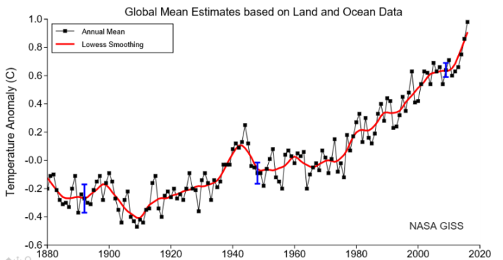
10/25/21: UN warns world is on course for Catastrophic Warming of 2.7°C

Slide 15

The IPCC calls for “unprecedented action”
It is possible:
United States production of Military Aircraft
<3,000 in 1939
Mid 1944 — 3,000 Every 11 Days

Slide 16
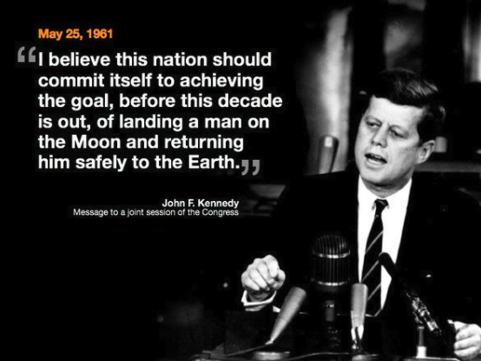
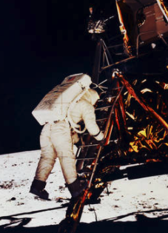

With vision, engagement, and commitment
On July 20, 1969, Apollo 11 astronaut
Edwin E. "Buzz" Aldrin walked on the Moon
On July 24, 1969, Apollo 11 returned safely to Earth

Slide 17
Where Do You Fit on the Continuum
As High-Performance becomes more pervasive…
Defense
Lack of knowledge about High-Performance will hurt my credibility… and business
Offense
Knowledge about High-Performance will be a positive differentiator

Slide 18



Marketing yourself as a
High-Performance Professional
What do we mean by High-Performance
Elements of Persuasive Communication (1 & 2)
Basic Marketing Concepts, Methods, and Messages
Building Blocks of Passive House Performance
Call to Action

Slide 19
Your Personal Objective for Today
Take a moment to think about it, and “raise you hand” to complete the sentence:
I am a (your role or aspiration) as a High-Performance Professional, and...
today will be perfect if...
(Limited to about 5 minutes total)
Notes:
A few volunteers so I can tune the presentation.

Slide 20

Marketing yourself as a
High-Performance Professional
What do we mean by High-Performance
Elements of Persuasive Communication (1 & 2)
Basic Marketing Concepts, Methods, and Messages
Building Blocks of Passive House Performance
Call to Action

Slide 21
High-Performance
Need Categories
  Energy Efficiency
  Comfort
  Health
  Resiliency
  Durability
  Reduced Maintenance
Environmentally Responsible Tactics
  Energy Efficiency
  Electrification (Eliminate Fossil Fuel Combustion)
  Embodied Carbon
  Renewables
  Energy Storage

Slide 22

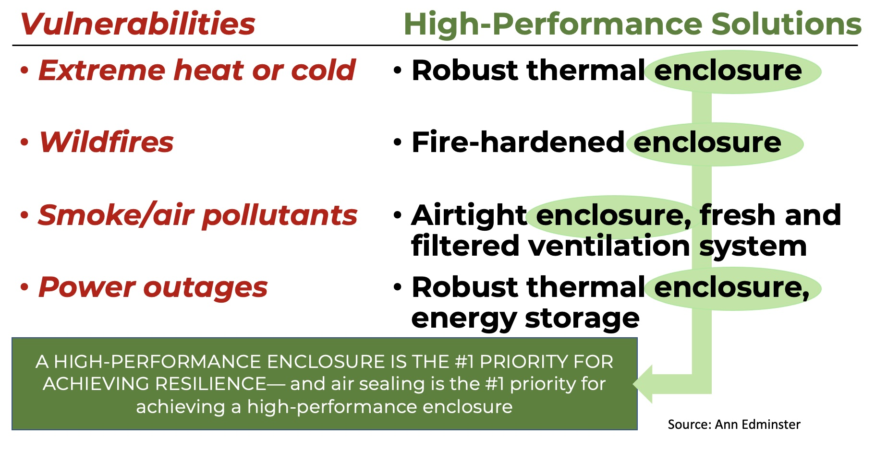
Climate Resilience

Slide 23

How is a resilient, passive house like a glider?
A small plane with out power can glide 20 miles, an airliner about 50 miles, while a glider can glide more than 200 miles ...
Hours a normal home without heat will
stay livable (above 40 degrees) for—
1950s home: 8
1980s home: 24
2009 home: 42
A passive house: 154
(More than SIX DAYS!)
Notes:
A small private aircraft will have a glide ratio of about 7 to 1, an airliner about 17 to 1 and a glider more like 70 to 1
From 20,000 feet (a little over 3 miles), without power to run the engines
A private aircraft can glide >20 miles before running out of of altitude and being forced to land
An airliner can glide >50 miles
A glider is able to glide >200 miles

Slide 24

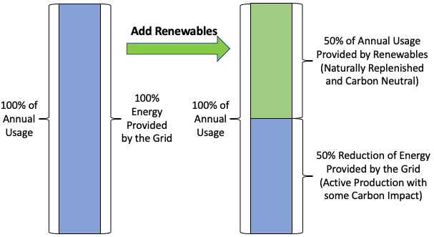
Efficiency is the first renewable
The 50% of energy that you are no longer purchasing from the grid costs you nothing, year after year. The least expensive energy is the energy that you do not use.
Notes:
Imagine you have a 2,000 SF home that is operating on about 12,000 kWh of electricity annually.
You install a small solar PV system that generates approximately 500 kWh of electricity monthly (6000 annually) and offsets about half of your energy bill.
The energy provided by the solar system is a carbon neutral resource that is naturally replenished, year after year — clearly renewable energy.
The result is an ongoing 50% reduction to the carbon impact of your home.

Slide 25
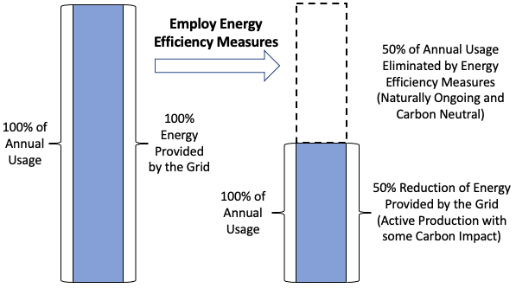
Efficiency is the first renewable
When you compare the relative outcomes, the results are essentially the same.
Both approaches are ongoing and carbon neutral.
Notes:
Now imagine that same 2,000 SF home, but instead of solar PV, you take actions to increase efficiency (air sealing, insulation, LEDs, heat pumps for heating/cooling and hot water, power strips, sensors/timers, and behavior).
The 50% reduction represents energy that you are not using due to the increased efficiency, is carbon neutral, naturally repeats year after year — technically not renewable energy but achieving the same result.
That result is an ongoing 50% reduction to the carbon impact of your home.

Slide 26
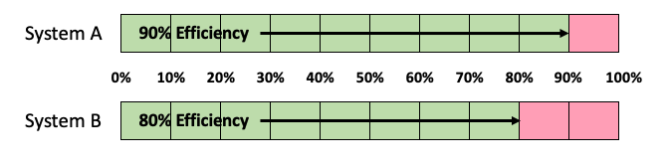
90% versus 80% efficiency
Seems like a pretty small difference
But it doubles the energy required!

Slide 27

The Evolution of Sustainability, 1960s – 2020s
THINK IT:
Conservation & activism – EDF, Greenpeace ...
CHOOSE IT:
Prescriptive Stds. –
Energy Star, LEED,
Build it Green
MEASURE IT:
Performance Stds. – Passive House, Living Building, WELL, RESET
PROVE IT:
Legislation,
Disclosure Ordinances,
Reach Codes…
HIGH PERFORMANCE
Notes:
Designing and building an affordable housing project requires a team approach — collaboration, consensus, and synchronized execution of a game plan with specific, defined objectives
Neither a joint effort of individuals, nor a relay race… it is a multi-year team performance

Slide 28
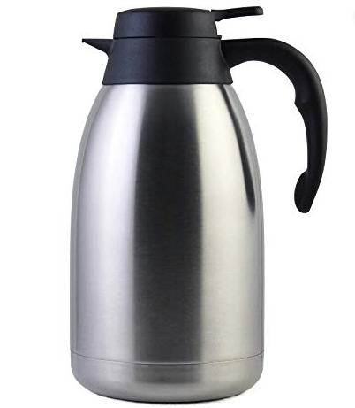
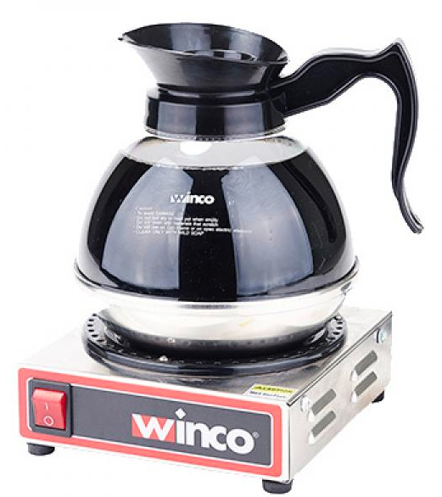
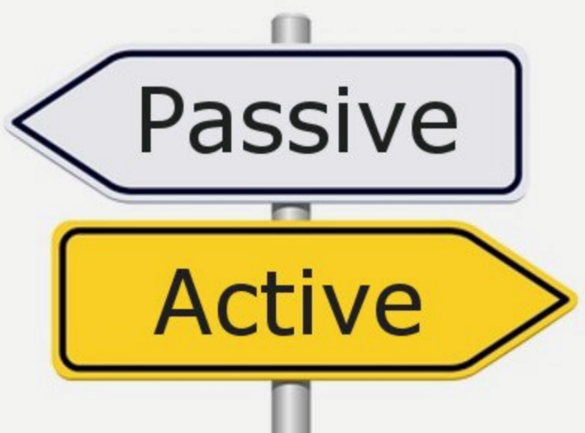
Passive – it’s in the name!
Notes:
Solutions that deliver desired performance naturally, as a function of design --
And continue to deliver that performance over time with little or no intervention other than normal maintenance

Slide 29
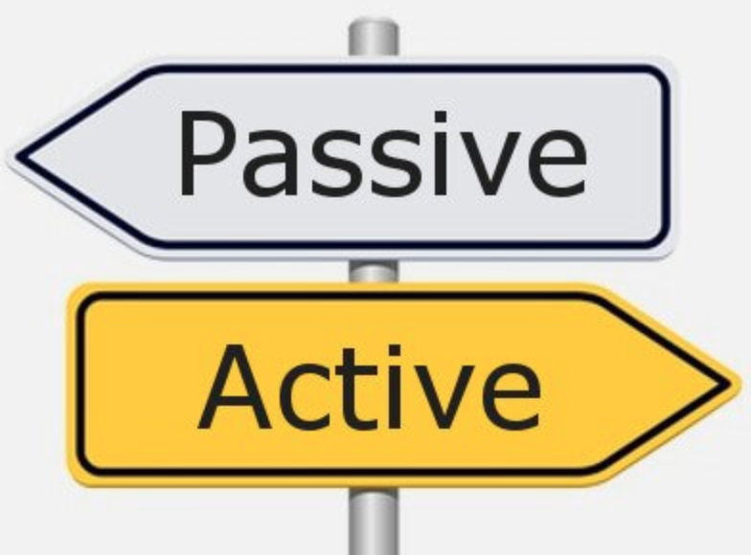
The Natural Order of Sustainability
Passive First
Active Second
Renewables Third

Slide 30
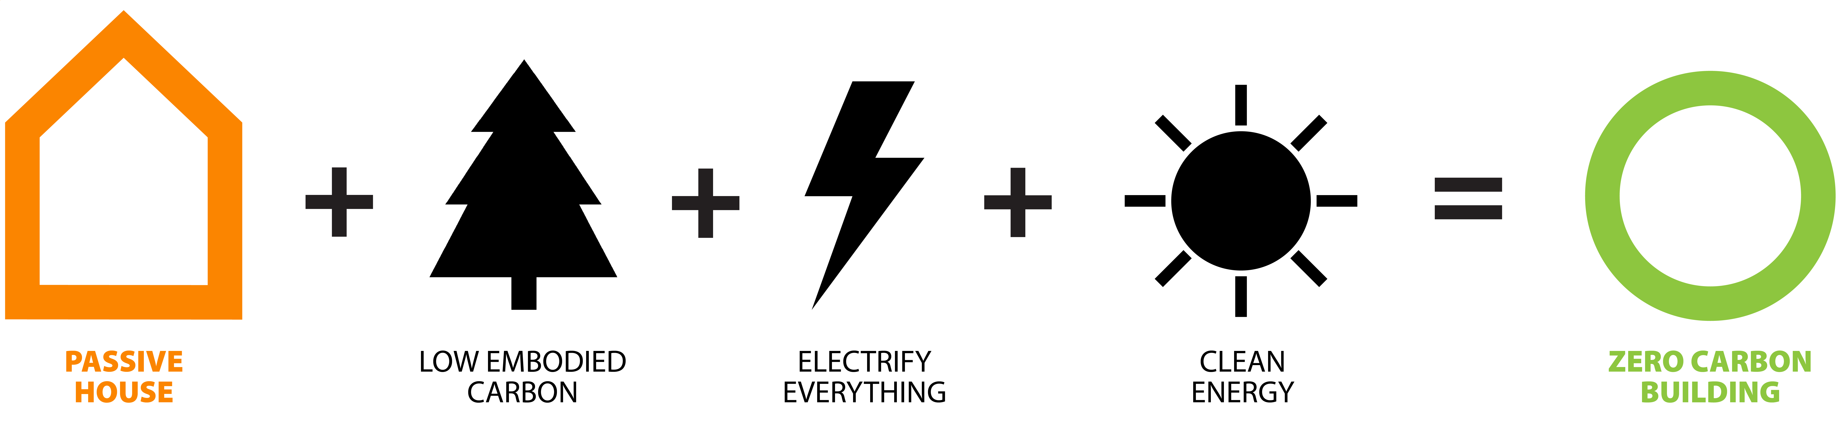
Natural Order of Decarbonization
New Building
Maximize Achievable Efficiency
Existing Building
Notes:
In all cases… an aspirational approach

Slide 31
Marketing yourself as a
High-Performance Professional
What do we mean by High-Performance
Elements of Persuasive Communication (1)
Basic Marketing Concepts, Methods, and Messages
Building Blocks of Passive House Performance
Call to Action

Slide 32
Sales for High-Performance Professionals
Having opportunities to SELL requires that you:
  Target, Contact, and Engage Prospective Customers
  Discover their Needs, Priorities, and Preferences
  Make connections between those Needs, Priorities, and Preferences — and what you have to offer
    Your knowledge, experience, and expertise
    Clarity regarding their needs, priorities, and preferences
    Less risk, fewer problems, and better outcomes
    A process, product, or project that delivers
    high-performance

Slide 33
Consultative Selling Process
Persuasive Communication Process
Build Trust, Credibility, and Rapport
Value
Proposition,
Presenting,
Proposing,
Handling
Objections
O
P
E
N
Strategic
Questioning
Prepare
Agree
Tools, Templates, Examples, Proofs

Slide 34
Client Decision Making Process
I have a need
I need information
I will listen
I will share information
I would hire you/your firm
I will commit to X now
No Need
No Trust
No Hurry

Slide 35
Measure of Success “Total Bases”
Number of At Bats
  If you get in front of more
  Prospects – you will have more successes
Batting Average
  If you raise your winning percentage – you will have more successes

Slide 36
Marketing yourself as a
High-Performance Professional
What do we mean by High-Performance
Elements of Persuasive Communication (1)
Basic Marketing Concepts, Methods, and Messages
Building Blocks of Passive House Performance
Call to Action

Slide 37
Business Management Process
Analyze, Plan, Allocate Resources
Implement
Optimize
Measure,
Track
Adjust

Slide 38

The Right Customers
Describe your Ideal Clients or
Prospective Clients
  What makes them Ideal for
  you/your business
  What makes you/your business
  the right choice for them
Do you have a sufficient flow of these Clients?
  If yes: How are you achieving this?
  If no: What do you think is getting in the way of your doing so?

Slide 39

The Right Project Mix
Describe your Ideal Project or
Type of Project:
  Why are these projects Ideal for
  you/your business?
  What makes you/your business
  the right choice for them?
Do you have your desired mix of projects/jobs?
  If yes: how are you achieving this?
  If no: what do you think is getting in the way of your doing so?

Slide 40
Looking Out – Looking In – Looking Forward
Looking In
  What are the things that you/your firm do best?
  What are the gaps, barriers, and/or bottlenecks that
  get in the way of your delivering on your promises?
Looking Forward
  What do you or your firm currently measure/track
  to evaluate how you are doing?
  If you had a “dashboard” that provided key measures of how well your or your firm’s business is performing – what would be on that dashboard?
  Do you or your firm have any strategic initiatives that are
  underway or under consideration?

Slide 41
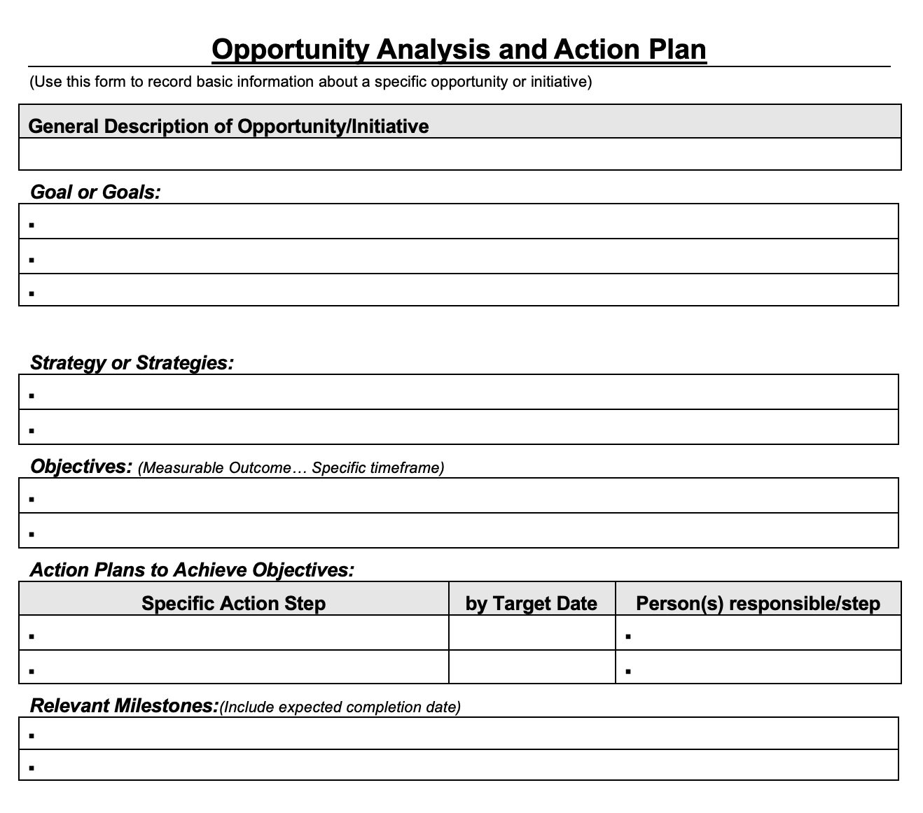
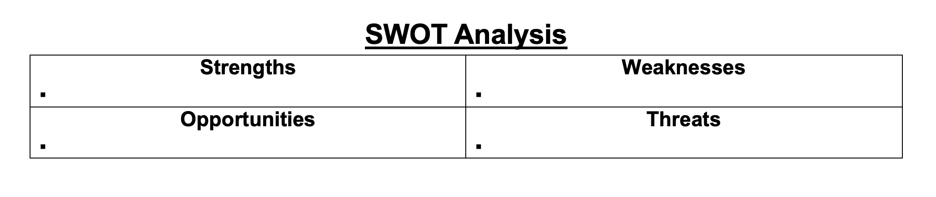
Possible Tools for Implementation
SWOT Analysis
Opportunity Analysis and Action Plan

Slide 42
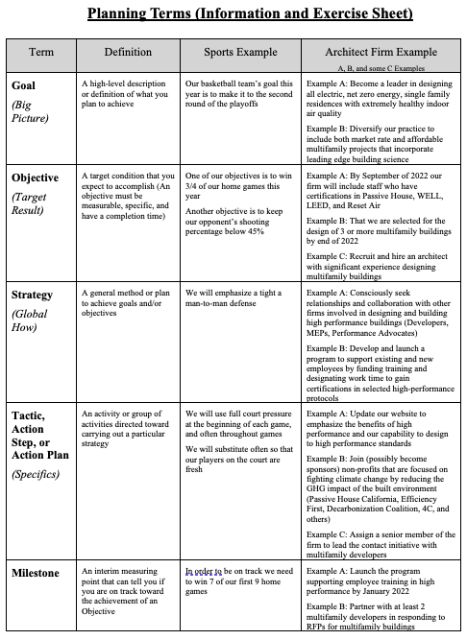

Slide 44
Measure of Success “Total Bases”
Number of At Bats
  If you get in front of more
  Prospects – you will have more successes
Batting Average
  If you raise your winning percentage – you will have more successes

Slide 45
Segmentation/Targeting/Positioning
Three step process
Segmentation: Divide the universe of possible Clients/Projects in logical ways
Targeting: Select which Clients/Projects are most logical for you to approach & engage
Positioning: Optimize your services for the selected target segments and create your marketing messages/materials to communicate and differentiate your capabilities, experience, and commitment

Slide 46

Segmentation
Consider Segmenting by:
  Demographic factors
  (age, family, income, etc.)
  Specific Needs/Priorities/
  Preferences
  Geography (primary
  and served)
The key…
Identifiable and Reachable
Notes:
Asthma
Pediatric

Slide 47
Targeting
Target the segment or segments that:
  Have a high percentage of your
  “Ideal Clients/Projects”
    Personal and financial profiles
    Likely needs/priorities/preferences
    Point of view
  Make logical business sense
    Fit with your expertise and capabilities
    Fit with your desired mix of Clients/Projects
    And/or fit with your aspirations for the future

Slide 48
Positioning
For your Target Market(s), what
  Needs do you meet
  Problems do you solve
  Opportunities do you provide
How does what you offer
  Reduce Risk
  Make things Faster or Easier
  Deliver a Better Outcome
  Provide Superior Value
What is your Evidence/Proof?
Customer

Slide 49
Marketing yourself as a
High-Performance Professional
What do we mean by High-Performance
Elements of Persuasive Communication (2)
Basic Marketing Concepts, Methods, and Messages
Building Blocks of Passive House Performance
Call to Action

Slide 50
Measure of Success “Total Bases”
Number of At Bats
  If you get in front of more
  Prospects – you will have more successes
Batting Average
  If you raise your winning percentage – you will have more successes

Slide 51
The Most Important Question
Why do Homeowners
or Businesses choose to Engage with in High-Performance Professionals?

Slide 52

The Answer
Because they have become convinced that it is a
Right Decision for them
  They expect it to
    Meet recognized Needs
    Solve recognized Problems
    Capture recognized Opportunities
They believe that it is a Good Idea and will Provide Value… a Smart Choice
Your job is to Communicate the Truth and enable them to make informed Smart Choices
Notes:
Your job as a sales person or advocate

Slide 53
Customer Decision Making Process
I have a need
I need information
I will listen
I will share information
I would buy from you
I will buy (specific) now
No Need
No Trust
No Hurry

Slide 54
Building Blocks of Credibility
Knowledge of the Specific Prospect/Customer
Your prospective Client’s situation, needs, problems, opportunities
priorities, goals, objectives, and resources
Knowledge: The Market and Available Alternatives
What are the problems, issues, opportunities, alternative
approaches, trade-offs and available incentives
Your Credibility
Knowledge: Expected Impact of what you have to offer
How your offerings, services, solutions, and capabilities
solve problems/capture opportunities/provide value
Knowledge: What you have to offer
Your offerings, services, solutions, and capabilities
54

Slide 55
Credibility & Influence are a product of Expertise and Perceived Intent
Building Blocks of Credibility
Knowledge of the Specific Prospect/Customer
Your prospective Client’s situation, needs, problems, opportunities
priorities, goals, objectives, and resources
Knowledge: The Market and Available Alternatives
What are the problems, issues, opportunities, alternative
approaches, trade-offs and available incentives
Your Credibility
Knowledge: Expected Impact of what you have to offer
How your offerings, services, solutions, and capabilities
solve problems/capture opportunities/provide value
Knowledge: What you have to offer
Your offerings, services, solutions, and capabilities
55

Slide 56

Gaining Influence
To become a Valued Consultant
  Educate your Client… help them understand
    Their own needs, priorities, and preferences
    Ideas, possibilities, trade-offs… as they relate to those needs, priorities, preferences, and realities
    Your capabilities, expertise, and commitment
  Put them in a position to make right choices
    For themselves — based on their own needs/priorities/preferences, and realities

Slide 57
Needs/Wants, Priorities, Preferences, Wants
Needs/Wants: Things that are required… or would be nice
  Three bedrooms, two baths
  Room for a piano or pool table
  Single story — wheelchair ramp
  A laundry room — off of the kitchen
  Separation of the master suite
  Vaulted ceiling in dining room
  + + +
Priorities: Things that enable choices between alternatives or across/among options
  Environmental Responsibility
  Healthy Indoor Air Quality
  + + +
Preferences: How things will work, or are desired to work
  Time and materials contract
  Bi-weekly onsite meetings
  Joint decisions throughout
  + + +

Slide 58
Client Decision Making Process
I have a need
I need information
I will listen
I will share information
I would hire you/your firm
I will commit to X now
No Need
No Trust
No Hurry

Slide 59
Business Category of Needs
Businesses invest in actions/initiatives to:
  Increase sales
  Reduce expenses
  Improve margins
  Enhance or preserve reputation
Also applies to your business
Notes:
On a personal level think of Maslow’s Hierarchy of Needs – Love and Belonging, Esteem, Self Actualization

Slide 60
Categories of Need for Home Improvement Products (Windows)
Decisions based on:
  Performance
  Appearance
  Impact on Lifestyle
  Environmental Responsibility
  Financial Impact

Slide 61
Categories of Homeowner Needs
Savings/Energy Efficiency (Financial)
    Save on energy bills every month and
    reduce risk of escalating bills over time
    Increase resale value or salability
    Take advantage of incentives
Comfort - Physical and Emotional
    Eliminate hot, cold or drafty spots/rooms
    Be able to keep home warmer or cooler
    within budget
    Provide comfortable, safe living environment
    for self and loved ones - peace of mind

Slide 62

Categories of Homeowner Needs
Health/Air Quality/Safety
    Reduce number of pollutants, allergens,
    and/or VOCs circulating through the inside air
    Control moisture and eliminate risk of mold and/or questionable smells
    Wildfires and smoke from wildfires
Environmental Responsibility
    Reduce Carbon Footprint
    Do the “right thing”- save the planet, reduce dependence on fossil fuel, create jobs

Slide 63
Persuasive Communication Process
Build Trust, Credibility, and Rapport
Value
Proposition,
Presenting,
Proposing,
Handling
Objections
O
P
E
N
Strategic
Questioning
Prepare
Agree
Tools, Templates, Examples, Proofs

Slide 64
OPEN
Objective – Of the Meeting/Presentation
“By the end of the meeting/presemtation...”
Plan – For the Meeting/Presentation
“First... and then... and then...”
Expectation – For the Meeting/Presentation
“It is my understanding that... time or situation”
Need – Reasons the homeowner(s), business owners chose to invest their time and consideration

Slide 65
Using OPEN
To organize for a Meeting/Presentation
  Why the attendees are choosing to meet
  What are your objectives for the meeting
  How do you plan for the meeting to unfold
  Any expectations to confirm or test
To begin the communication portion
  Everyone gets on the same page… and plan
  Order is unimportant – I like NEPO
Worst case – you discover misalignment early

Slide 66
Welcome Again...
  Gaining traction as a High-Performance Professional is both logical — and challenging
    Emerging Industry – growing, identifiable, increasing awareness, and incentives
    Developing Marketplace – continuous evolution, misinformation, real $ today for projected returns tomorrow
  Today’s 90-minute webinar will enhance your ability
  to communicate the Value of High-Performance
    Concepts, techniques, skills, tools, and application
  Objective: That you understand, consider, and evaluate
    Put you in a position to make informed choices on
    whether and what might potentially work for YOU
Need
Expectation
Plan
Objective

Slide 67
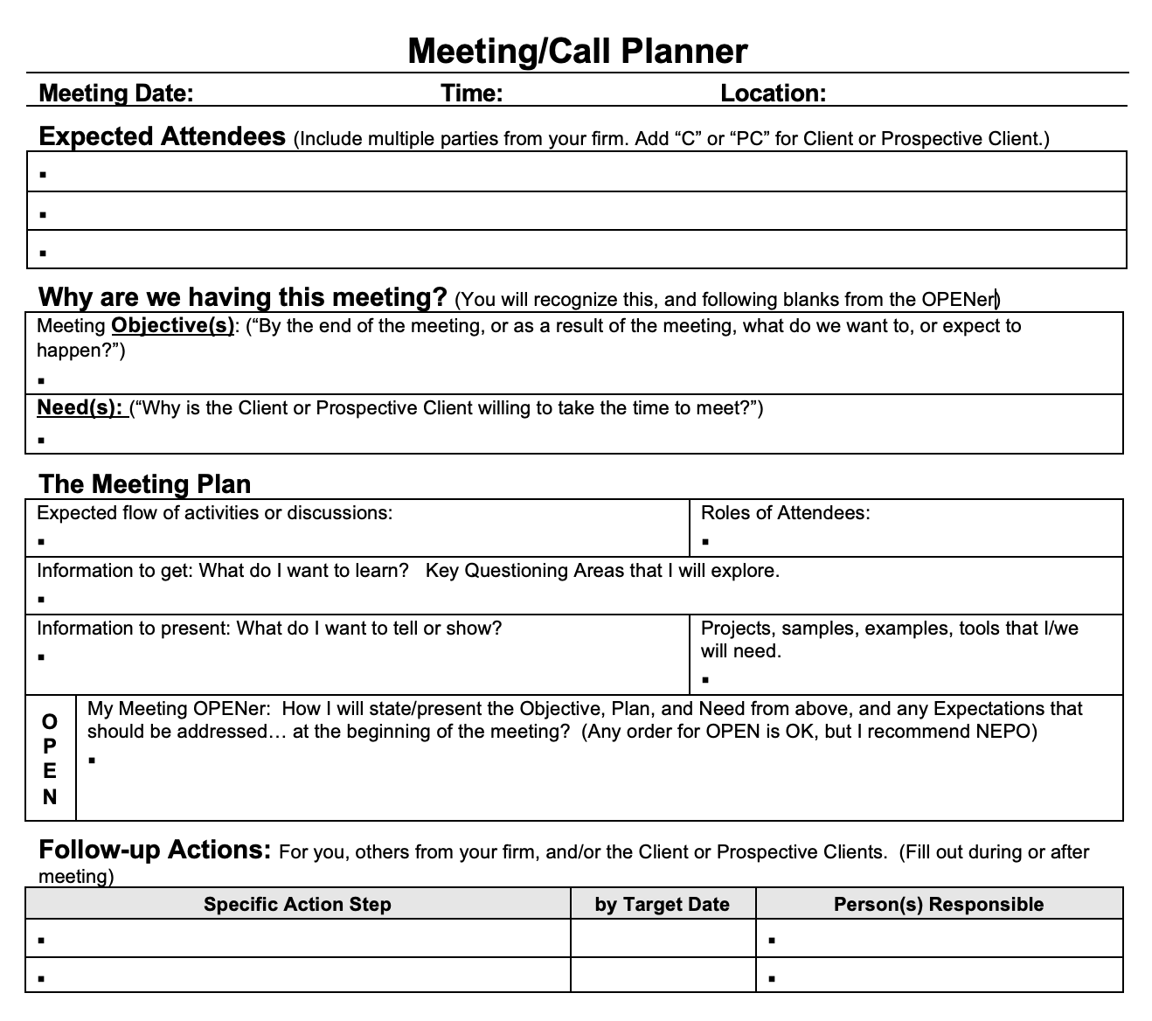
Possible Tool for Implementation
Meeting/
Presentation Planner
  Objective
  Plan
  Expectation
  Need

Slide 68
Persuasive Communication Process
Build Trust, Credibility, and Rapport
Value
Proposition,
Presenting,
Proposing,
Handling
Objections
O
P
E
N
Strategic
Questioning
Prepare
Agree
Tools, Templates, Examples, Proofs

Slide 69
Strategic Questioning Concepts
The Client Conversation
  Intake process, conversations, meetings
Topic and Follow up Questions
  The Change Question
  Categories of Need
  Include Performance Elements
Earn to Learn Question Format
  Provide context/show expertise/
  introduce topics
Problem – Cause – Impact
  Establish alignment and importance
The person asking the questions is in control of the conversation!

Slide 70
The Client Conversation
Introduce a Topic
with an Opening
Question
You already do this… (listening and responding)
When you are “engaged” in meaningful conversation
Listen to the
Answer and
either…
Ask a Follow-on
Question to Explore
the Topic
Listen to the
Answer and
either…

Slide 71
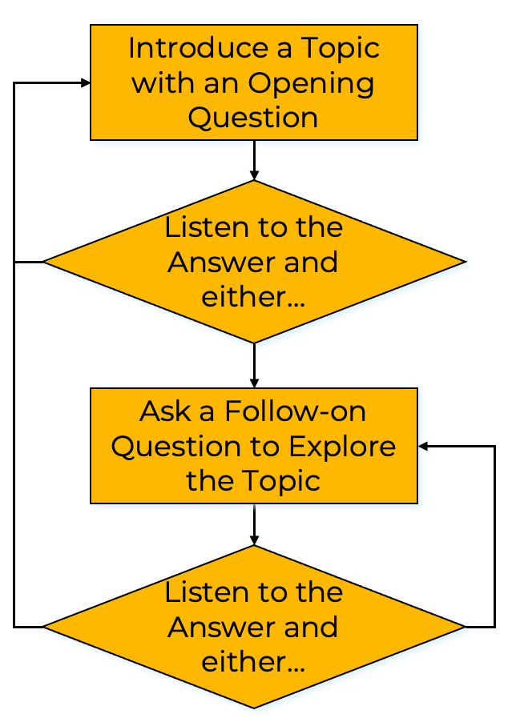
Topic and Follow-up Questions
  Begin with the Change Question
  Listen to the answer and based on the answer,
  ask follow up questions
  The Client or prospective Client will lead you to
  their needs, problems, perceptions, priorities, and preferences

Slide 72
Begin with “The Change Question”
  “What has changed or is about to change that makes now the time for you to consider investing in ...?”
  They will answer with
    Meet a Want, Need, or Priority
    Problems or issues that they are hoping to eliminate or avoid
    Opportunities that they are hoping to capture
  These will drive their choices — whether to go forward, with whom they engage, decisions along the way
  Your questioning, engagement process, and ultimately your work product should be tailored to address these Needs, Priorities, Problems and/or Opportunities

Slide 73
Change Question: Example
After introductions you open the conversation with
the Change Question — “What has changed or is about to change that has caused you to consider (what you are selling/advocating) at this time?”
They answer: “We are about to become grandparents and are concerned about being environmentally responsible for the future.”
  What would you ask next?
Notes:
When you say environmentally responsible... what to you mean?
Concerned about what?

Slide 74
Change Question: Examples
If they had answered:
“Some friends have just (did what you are advocating) and they are really happy about the results.”
“My grandfather is moving in with us and we want to make our home safer and more healthy for him.”
“Due to the pandemic, both of us are now working from home and our utility bills have gone through the roof.”
  What would you ask next?
Notes:
What are they happy about... How is your situation similar to theirs?
What do you mean by safer... More healthy? Does your grandfather have health issues concern you?
What utility bills are you referring to... What does “through the roof”mean?

Slide 75
Topic and Follow-up Questions
  Introduce a topic with a Question
    The “Change” Question
    Related to Categories of Need
    Suspected Areas of Interest
    Things that Differentiates You/Your Firm
    Questions to uncover Performance Needs/Priorities

Slide 76
Earn to Learn Questions
Provide information, insight, or justification
  There is growing urgency to reduce GHGs from building operations… (pick the subject)
  In recent years we have been paying more attention to healthy indoor air quality… (pick the subject)
  (X) is an important factor in (pick the subject)
  During our earlier interview you (pick the subject)
Bridge to a question that asks for their situation, opinion, preference, or priorities
  Where does that fit into your priorities for your new home?
  Would you be interested in learning more about how?
  Should we incorporate those factors into your design?
  Gave your priorities shifted as you have gained current information?

Slide 77
Earn to Learn Questioning
Provides the opportunity to introduce questions in areas where you may be able to provide value
Lowers the barrier to being honest and candid because it provides a basis for your question
Encourages your Customers to provide relevant insights/issues in areas that they might not think of on their own
Allows you to establish yourself as having knowledge that is useful and that you are a problem solver... Credibility and Trust

Slide 78
Earn to Learn Examples
The recent smoke from wildfires and the pandemic have raised awareness of managing indoor air quality. Is having access to continuous fresh and filtered air a priority for you and your family?
We have designed several homes and that have earned certification as “high-performance” buildings. What is your thinking regarding energy efficiency, comfort, health and other performance factors?
Having reviewed your energy report, I see that your home uses quite a bit of energy for its size. Do you agree that we should address this issue as a part of the remodel and addition of the new master suite?

Slide 79
Earn to Learn Examples
Building science tells us that a nearly airtight building envelope enables extreme energy efficiency and healthy indoor air quality. Are you interested in efficiency, air quality, and other high-performance factors in your new home?
Many of my existing Clients selected (company or solution) because of our expertise in the incorporation of renewables and storage to increase resiliency. Is resiliency a high priority for your family?
Currently, there are multiple rebate programs for shifting from natural gas to electricity for space and water heating? Are you familiar with heat pumps, and have you considered replacing your gas operated furnace and/or water heater
as a part of your remodel?

Slide 80
Problem – Cause – Impact
Questions uncover Problems
Your value is in the Solutions that you provide
When you uncover a problem — ASK…
  What do you believe is Causing that?
    Will tell you if you can help
    Presents the opportunity to provide expertise
  How is that Impacting you or your family?
    Will tell you if it is important… and how important

Slide 81
Persuasive Communication Process
Build Trust, Credibility, and Rapport
Value
Proposition,
Presenting,
Proposing,
Handling
Objections
O
P
E
N
Strategic
Questioning
Prepare
Agree
Tools, Templates, Examples, Proofs

Slide 82
Measure of Success “Total Bases”
Number of At Bats
  If you get in front of more
  Prospects – you will have more successes
Batting Average
  If you raise your winning percentage – you will have more successes
Notes:
Because the concepts of Value Propositions, Presentations, and Proposals also apply to the messaging included in marketing tools (Flyers, Brochures, Tri-folds, your Website

Slide 83
Definitions:
  Feature
  Characteristic of a product/service, easily understood or demonstrated
  Function
  How the feature works in order to provide the benefit or benefits
  Benefit
  What the Customer gains from the feature/features and their functions
  Need
  More fundamental... makes the benefit relevant to the Customer

Slide 84

How Cool is That!
This is the cup I’m selling
It comes with
a handle
How cool is that?

Slide 85
Feature – Function - Benefit
My cup comes with this handle
The handle enables me to drink without touching the cup
I can drink hot coffee or tea without burning myself
How cool is that?

Slide 86
Need – Benefit - Feature
You have told me that you like your coffee hot
I assume you don’t want to burn yourself
That is why my coffee cup has this handle
How smart is that?

Slide 87
3 Reasons for Need – Benefit – Feature
You begin with something
that you know about the prospective customer
You finish with something that is easily observed, understood, or demonstrated
It keeps you from talking about features and benefits that don’t matter
Results in a Nod
Another Nod
Not tied to a Need,
a waste of time

Slide 88
Linking N-F-F-B
Benefits
Begin with:
Features
Needs
or Need
Categories
Any Order OK
Functions

Slide 89
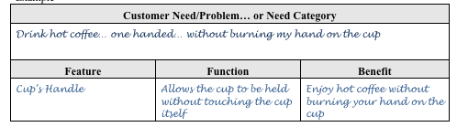
Presentation Builder: Example
You have told me that you like to drink your coffee very hot
You don’t want to burn your hand on the cup
That is why my cup comes with this handle
You don’t have to touch the cup when you drink

Slide 90
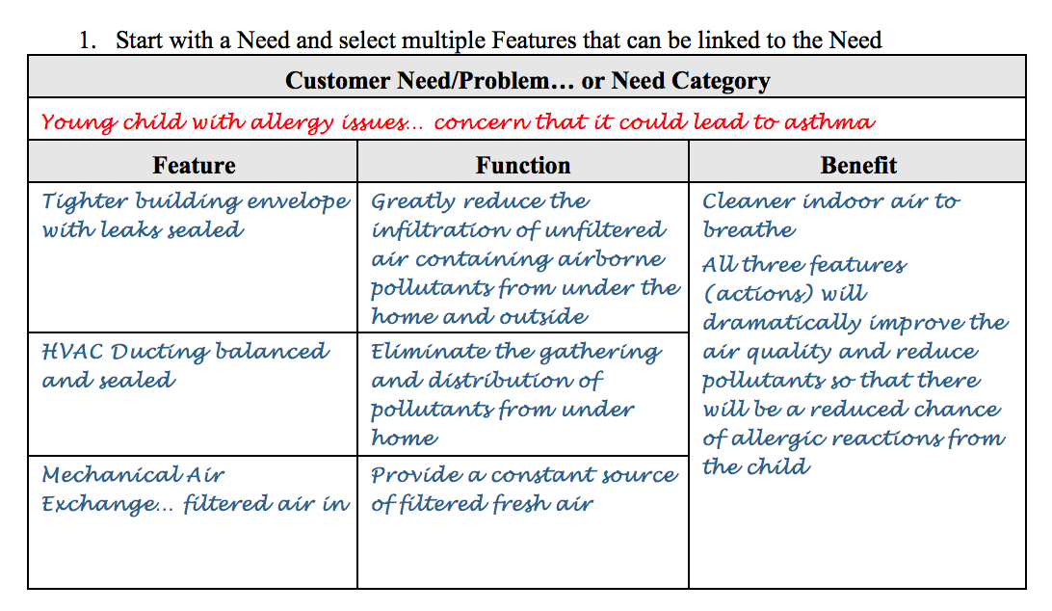
Presentation Builder: Example

Slide 91
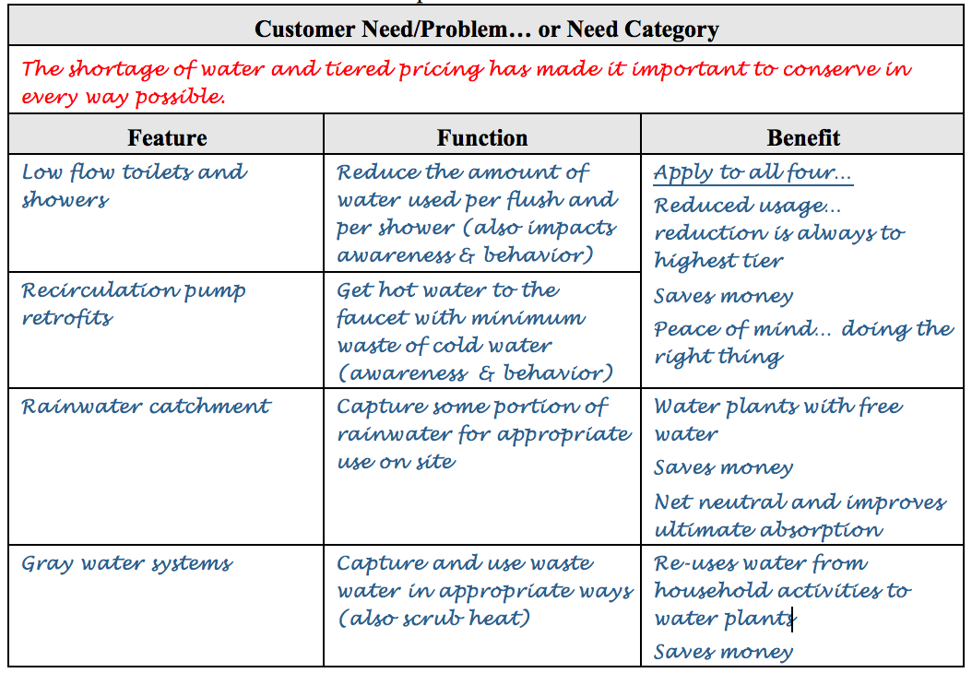
Need first…

Slide 92
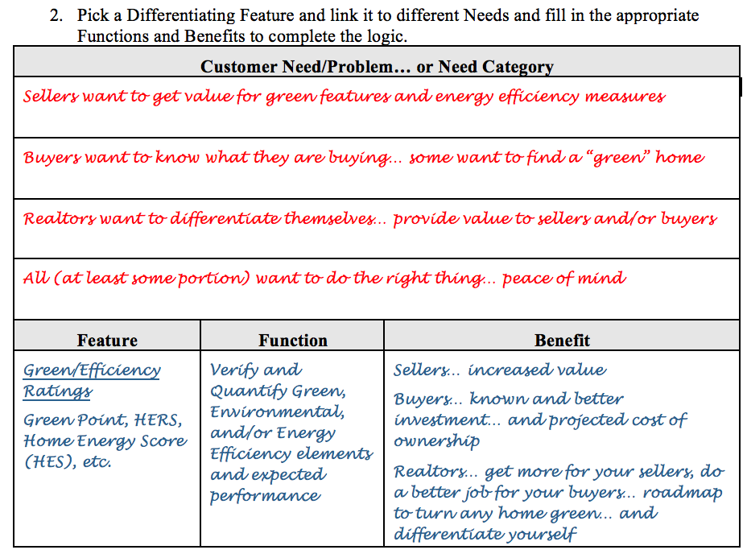
Differentiating Feature first

Slide 93
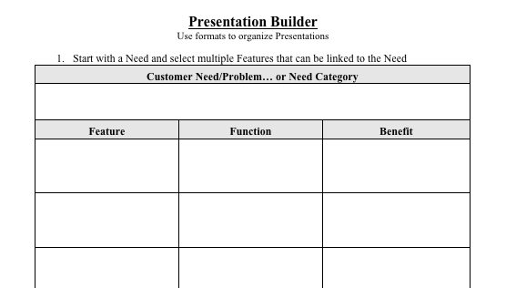
Presentation Builder

Slide 94
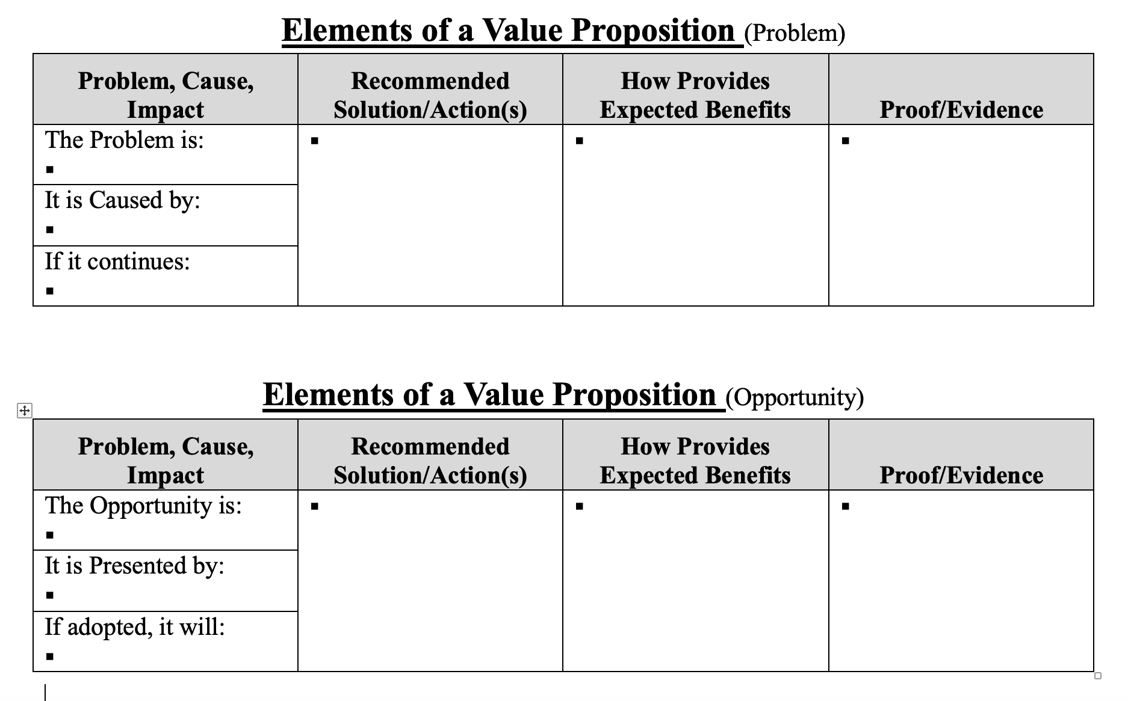
Value Propositions

Slide 95
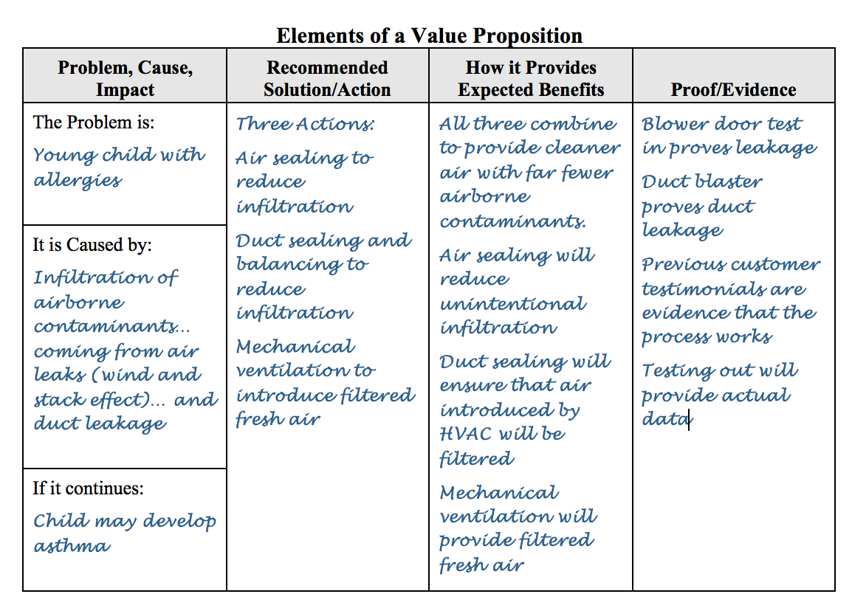

Slide 96
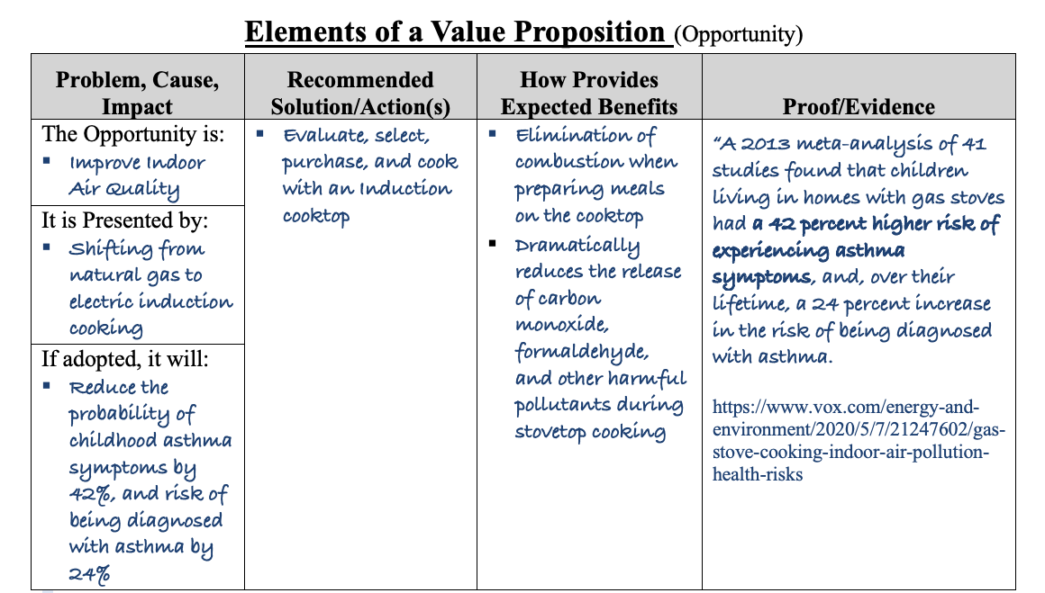

Slide 97
Tips for Marketing Messages
It is about the People... not the Product, Project or Service
Begin with questions related to Needs, Problems, and/or Opportunities
  Uncovers possible interest and awareness
  Qualifies potential customers
Connect your capabilities/products/services to the meeting Needs, solving Problems and/or capturing Opportunities
Consider elements and unfolding order of the Presentation Builder (NBF) and/or Value Proposition
Desire to get something is less important than the fear of missing out

Slide 98
Tips for Marketing Behaviors (the next opportunity)
Five – Five – Ten
  When on appointments and/or during delivery/installation/etc.
  Knocking and handing out or door hanger/information/etc.
  Include explanation of today, process, potential requests, and invitations
Signage
  Yard signs, before, during, and after a job
  On your vehicle or company vehicles (Needs first)
Make relevant observations when you arrive (neighborhood and home/business)
Ask “what else” and ”who else” before departing

Slide 99
Useful Phrases
Quality is more than the absence of defects — It is the presence of value
  Code is the minimum acceptable standard (pass/fail)
  It is about eliminating known defects (example: 24x7 bathroom fan)
Performance is an element of Quality
  Owners choose perceived quality
  (appliances, cabinets, countertops, fabrics, finishes, etc.)
  Yet often allow construction based the minimum legal requirements
Future Proof your home/building (code cycles)

Slide 100
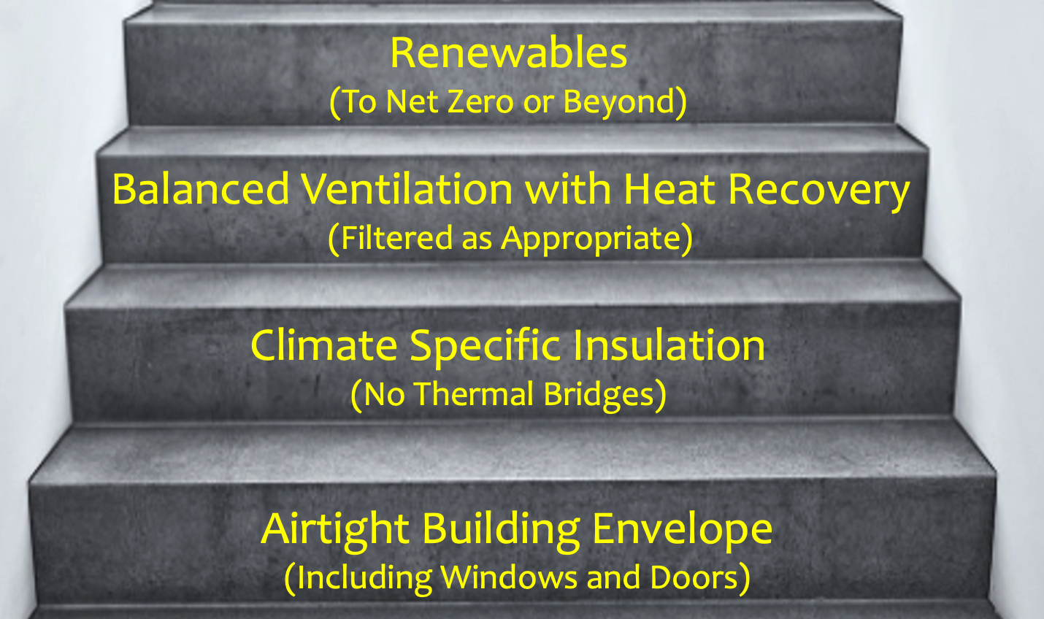
Marketing yourself as a
High-Performance Professional
What do we mean by High-Performance
Elements of Persuasive Communication
Basic Marketing Concepts, Methods, and Messages
Building Blocks of Passive House Performance
Call to Action

Slide 101
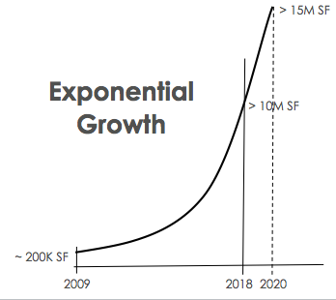
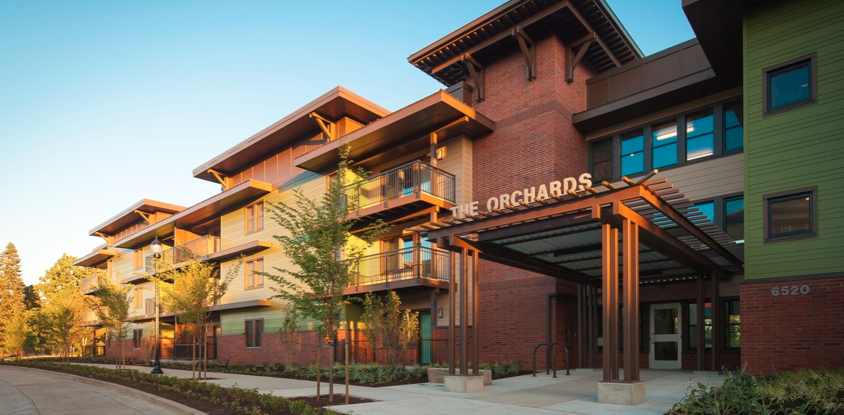
Passive House
has Arrived
“The United Nations endorsed Passive House as a global standard at the recent North American Passive House Network conference… Deputy Secretary-General Amina J. Mohammad described Passive House as a model for the developing world… and the developed world”
Originally published on the EcoReport (2017)

Slide 102

Passive House

Slide 103
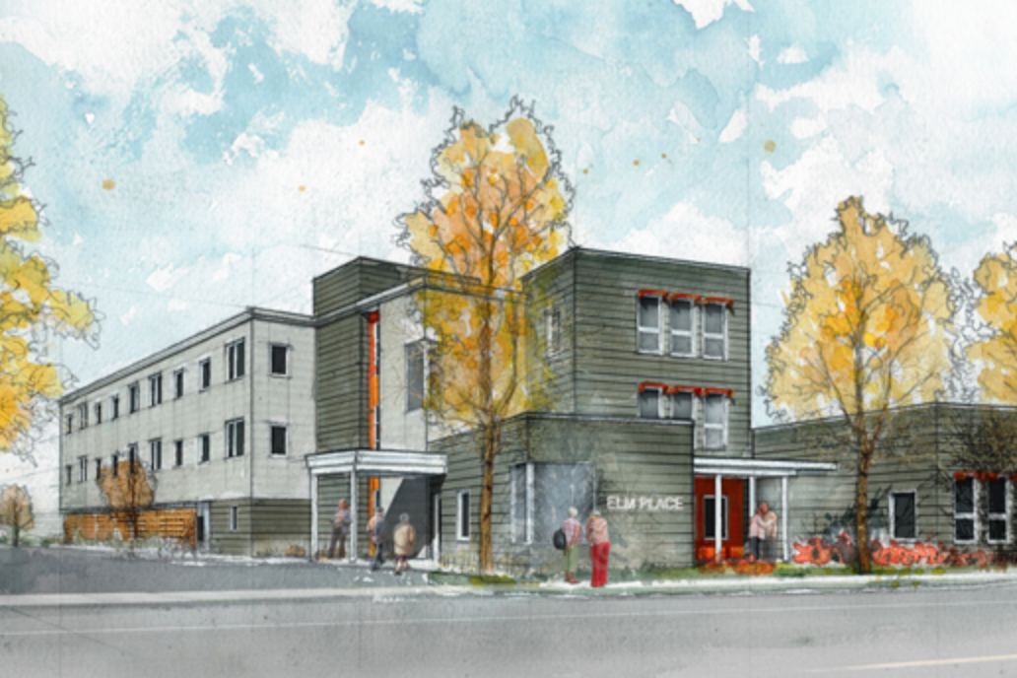
Passive House Multifamily

Slide 104
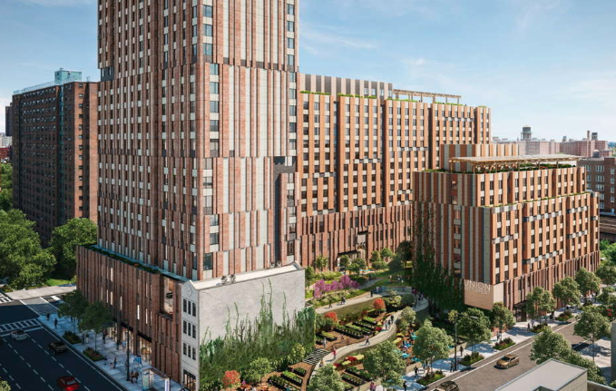
Passive House City Block
750,000 sq. ft. Mixed Use, with
655 Affordable Units, plus Commercial Space and a School

Slide 105
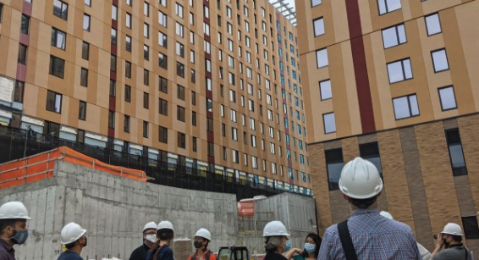

Slide 106

Building Blocks to Achieve High Performance
Renewables
(To Net Zero or Beyond)
Balanced Ventilation with Heat Recovery
(Filtered as Appropriate)
Climate Specific Insulation
(No Thermal Bridges)
Airtight Building Envelope
(Including Windows and Doors)
Notes:
It is about the envelope… predictive analysis, measurement and verification

Slide 107


An Airtight Shell or Envelope
Sufficient Insulation
(to avoid the intrusion of heat from the outside or the loss of heat from inside)
Continuous Fresh Air
Notes:
Function plus Performance – minimum input
Velcro, airtight, balanced
Smart

Slide 108
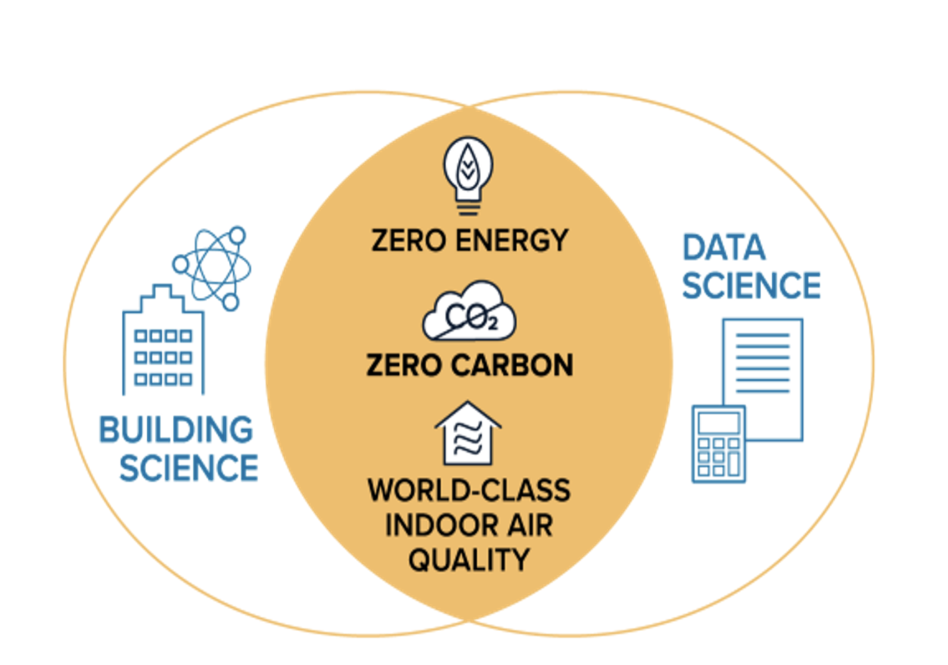
The key building science enabler to affordable ZNE/ZNC & healthy IAQ is Passive House
The key data science enabler to evidence-based performance is physics-based modeling and simulation
Integration of Passive House Standards
Incorporating Passive House strategies for the envelope most affordably enables extreme energy efficiency, healthy indoor air quality, and resilience.
Passive House delivers the most aggressive reduction of energy consumption, making the path to zero energy and zero carbon more predictable and less risky.
The integration of Passive House works synergistically with other standards
because PH is more stringent and sets the bar higher in terms of energy
efficiency, healthy indoor air quality, and resilience.
Notes:
MacLeamy curve

Slide 109

Marketing yourself as a
High-Performance Professional
“Do the best that you can until you know better. Then, when you know better, do better.” Maya Angelou
What do we mean by High-Performance
Elements of Persuasive Communication (1)
Basic Marketing Concepts, Methods, and Messages
Building Blocks of Passive House Performance
Call to Action

Slide 110
You are a part of that UNPRECEDENTED ACTION
The IPCC calls for “unprecedented action”
It is possible:
United States production of Military Aircraft
<3,000 in 1939
Mid 1944 — 3,000 Every 11 Days

Slide 111
Stay Informed – Get Involved
Stay up to date on what is possible and what is coming
Look for opportunities to be involved and make a difference within your organization, your community, your jurisdiction
Critical Steps to Success
  Educate Everyone
  Proof of Concept (Pilot Projects)
Notes:
Electrification, Airtightness, Energy efficiency, Balanced ventilation, Embodied Carbon, battery storage, Insulation levels, Renewables

Slide 112

Jay Gentry
Jay.gentry@passivehousecal.org
(831) 320-8538
Thank You for Your
Time and Attention

Slide 113
And if you are interested: November 8, Noon to 1:30
“High-Performance as the Baseline”
High-performance is recognized as the future of the built environment. However, even as we promote high-performance design and construction as providing significant benefits for owners, occupants, and the environment, we depict it as “upgrades” that are well worth the additional investment required.
It is both important and urgent that change to positioning high-performance as the logical and appropriate baseline rather than positive options that require a premium.

Slide 114
Closing
Continuing Education Units Available
  Contact ian.logan@ventura.org for AIA LU's
Coming to Your Inbox Soon!
  Slides, Recording, & Survey – Please Take It and Help Us Out!
Upcoming Courses:
  Duct Leakage Testing: Basics & Beyond (8/16)
  Stay Cool This Summer with Higher-Performing Air Conditioning (8/30)
  The Value of Becoming a Certified Energy Analyst [CEA] (8/31)
  Heat Pump Fundamentals: Space Conditioning and Water Heating (9/13)
  Home Remodeling – Fire Resiliency & Electrification (9/27)
Notes:
Thank you All! To those of you who are new to our network, WELCOME.
AIA LU’s are available for today, Please contact me if you have any questions.
You will receive the recording, slides from today, and a follow up survey via email
I want to also take this opportunity to let you know of a few upcoming trainings, especially if you would like to reinforce what you have learned here today.
May 19: All Electric Construction Part 1 & Part 2 on June 8
May 26: HERS Registry Training for Public Sector Staff
June 9: Green Real Estate Marketing
June 15: Upcoming Regional Forum
Ongoing training Series on Soft Skills in Business Development, taught by Jay Gentry
Please Visit our website 3C-REN.org to find event specifics and registration

Slide 115


Thank you!
For more info:
3c-ren.org
For questions:
info@3c-ren.org
Notes:
Thank you All! To those of you who are new to our network, WELCOME.
Thank you. You can learn more at 3C-REN.org or contact us at info@3C-REN.org.

